Slide 1
Raspberry Pi

Slide 2
What is Raspberry Pi
Raspberry Pi is a credit card sized Computer
Raspberry Pi can run many operating systems using Linux
Raspberry Pi has Following Interfaces
USB
HDMI
Stereo Audio out
GPIO
LAN
Serial Camera
Serial Touch Screen

Slide 3
Raspberry Pi
Developed in UK by Raspberry Pi Foundation
Promote Programming Education
ARM based Complete Computer
USB, LAN, HDMI, Audio, GPIO
Micro USB Power
SD Card as storage
Very Small Form Factor

Slide 4
What Raspberry pi is NOT
Raspberry Pi is not a microcontroller or microprocessor, it’s a complete computer
Raspberry pi is not name of any IC
Raspberry pi is not the name of any Software
Raspberry pi is not programming language
Raspberry pi is simply a COMPUTER in a very small size

Slide 5
Why?
Embedded Systems are getting very demanding these days
High processing requires a descent operating systems like Linux
Boards running linux are very costly
Learning Computer in very cost effective way is need of time
Development of a very cost effective learning and application platform

Slide 6
Primary Objective
Main purpose of building raspberry pi was to enable kids across the globe to learn computer
By providing a Computer to as low as USD 35, raspi is the cheapest computer in world
To teach programming language to kids
To enable hackers and developers develop interesting systems

Slide 7
Applications
School, colleges to teach programming
Embedded Systems Application
Computer Vision Applications
POS
Defense products
Many real systems are being built on raspberry pi

Slide 8
Raspberry Pi 3
CPU: Quad-core 64-bit ARM Cortex A53 BCM2837 clocked at 1.2 GHz.
GPU: 400MHz VideoCore IV multimedia.
1 GB RAM
4 x USB Ports
On-Board Wifi and Bluetooth
Video outputs: HDMI, composite video (PAL and NTSC) via 3.5 mm jack.
Network: 10/100Mbps Ethernet and 802.11n Wireless LAN.
Bluetooth: 4.1

Slide 9
Pi Versions
Model A
Model B
Model B+
Model 2 B+
Model 3 B+
Pi Zero
Pi Zero W

Slide 10
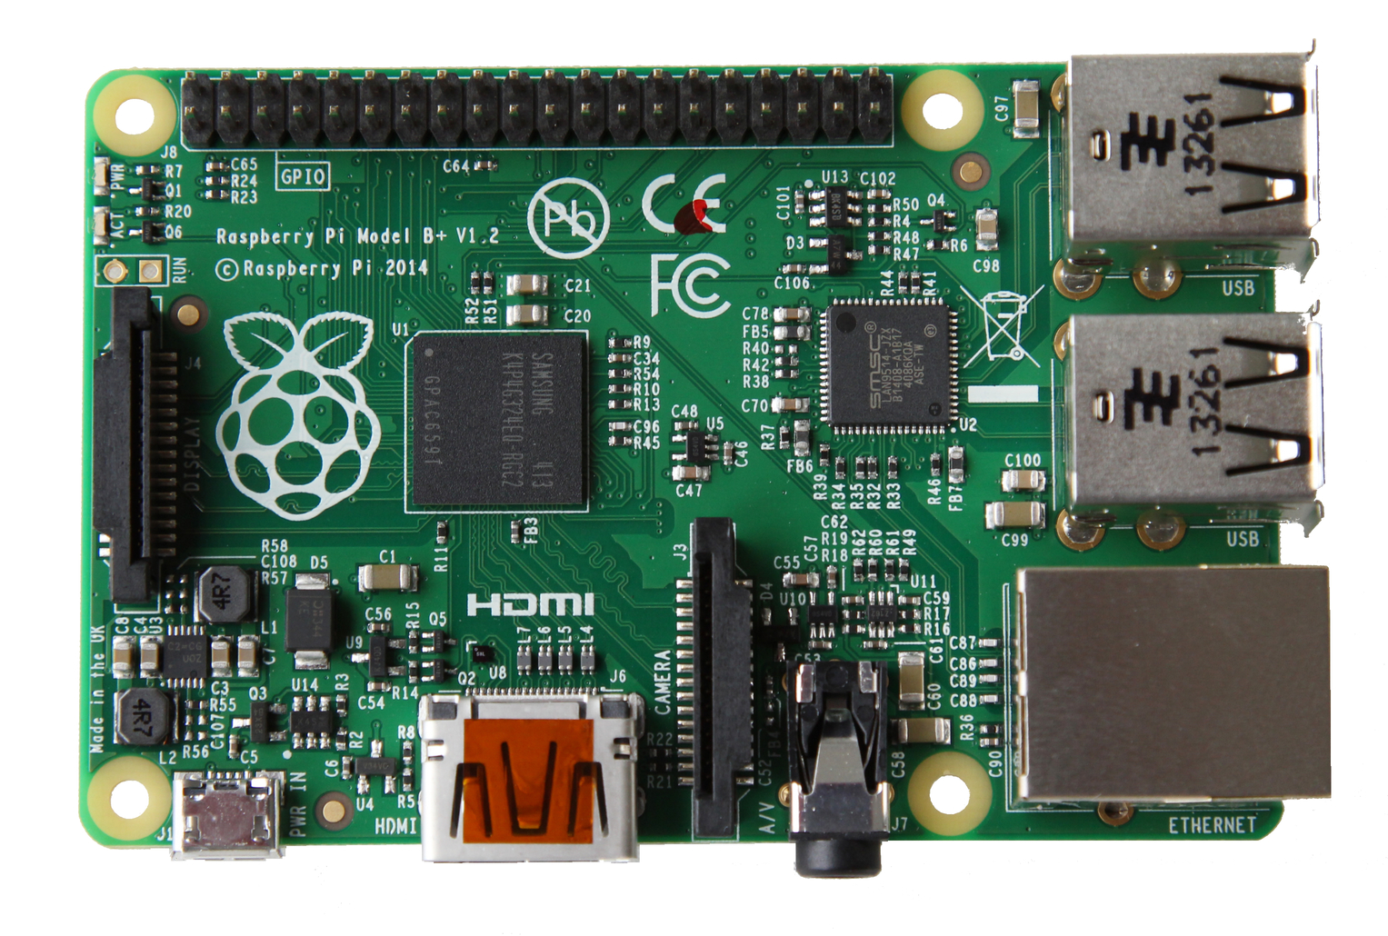
RPi

Slide 11
Kit Components
Essential:
Raspberry Pi board
Prepared Operating System SD Card
USB keyboard
Display (with HDMI, DVI, or Composite input)
Power Supply
Highly suggested extras include:
USB mouse
Internet connectivity - LAN cable
Powered USB Hub
Case

Slide 12
Programming Languages
The Raspberry Pi Foundation recommends Python
Any language which will compile for ARMv6 can be used
Installed by default on the Raspberry Pi:
C
C++
Java
Scratch
Ruby
Python

Slide 13
Using RPi
Install Operating System on SD Card
Connect Display, KBD and Mouse
Use as Computer
Program in Python or C
Python is official Programming Language
Interface with devices and sensors through GPIO

Slide 14
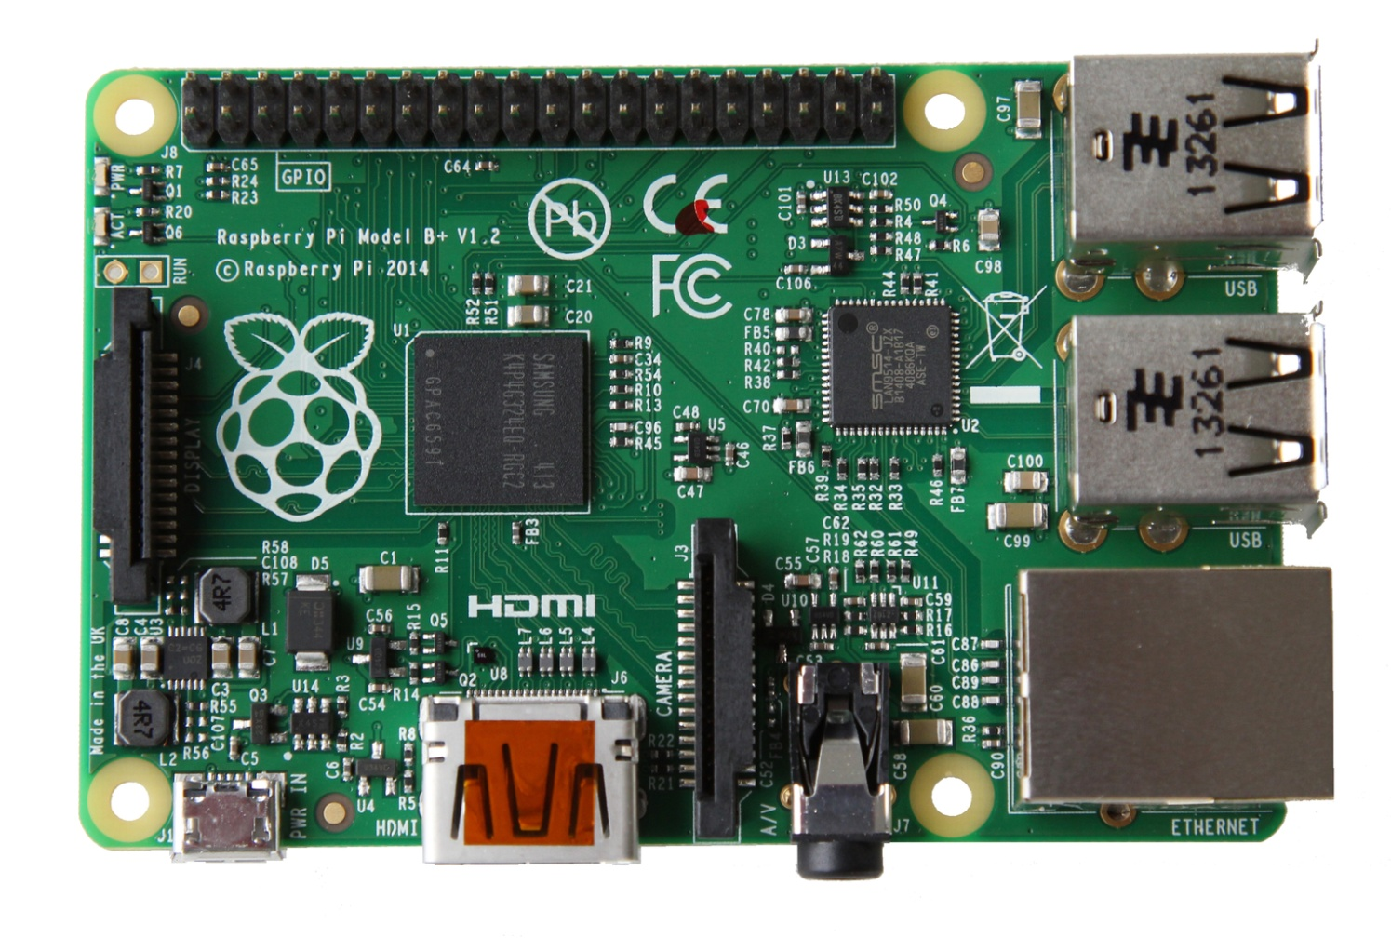
Power
5v micro
USB connector
(Similar to the one on a lot of mobile phones!)

Slide 15
HDMI
HDMI Audio & Video
(works with modern TVs and DVI monitors)

Slide 16
Connectivity
4 x USB 2.0
ports
GPIO
(General
Purpose
Input &
Output)
10/100Mb
Ethernet

Slide 17
Pi Instalation
Format SD Card using SDFormatter
Keep the Expand File System Option ON
Copy NOOBS
Insert SD Card into Raspberry Pi
Connect Keyboard mouse and display
Power On the Raspberry Pi

Slide 18
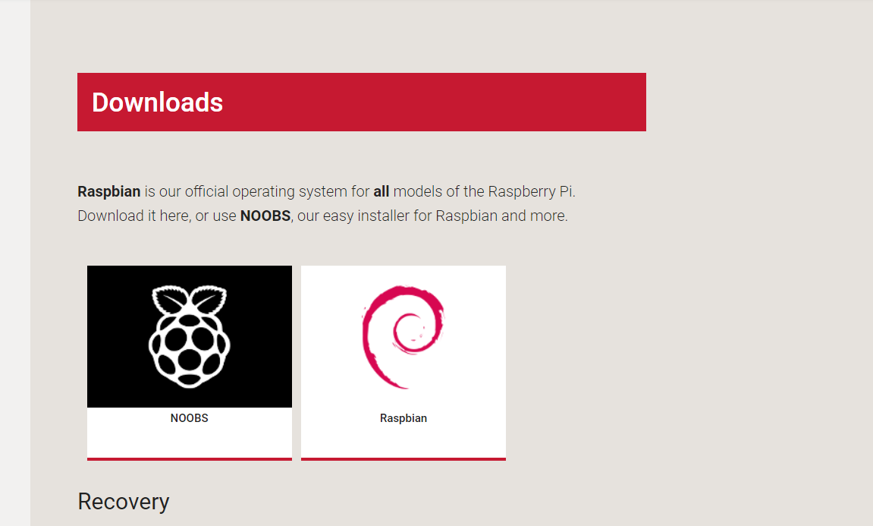
Raspbian

Slide 19
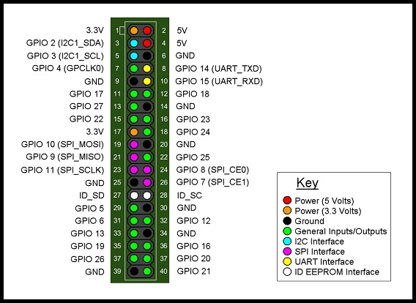
RPi

Slide 20
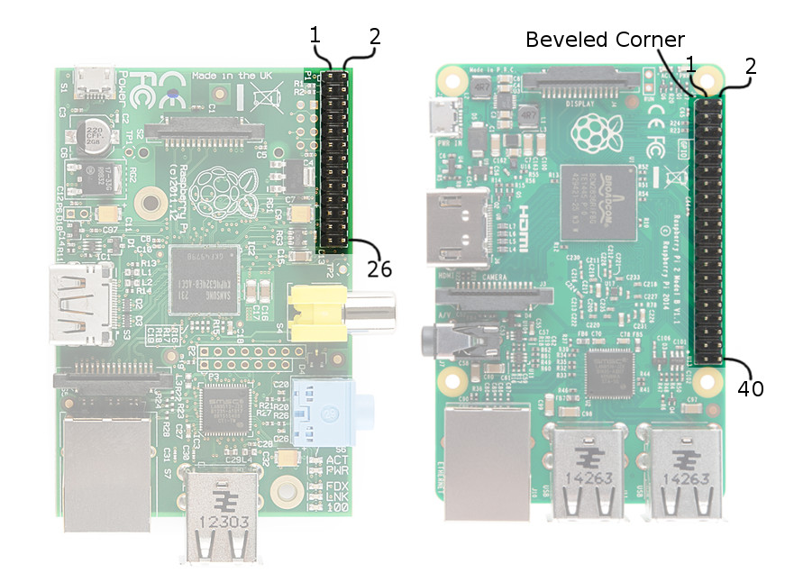

Slide 21
Packages Install
sudo apt-get update
sudo apt-get upgrade
sudo apt-get install python-dev
sudo apt-get install python-pip
sudo apt-get install python-rpi.gpio
sudo apt-get install idle3

Slide 22
Using GPIO Output
led1 = 21
import RPi.GPIO as GPIO
import time
GPIO.setmode(GPIO.BCM)
GPIO.setmode(GPIO.BOARD)
GPIO.setup(led1, GPIO.OUT)
while True:
GPIO.output(led1, True) OR
GPIO.output(led1, GPIO.HIGH)
time.sleep(0.3)
GPIO.output(led1, False) OR
GPIO.output(led1, GPIO.LOW)
time.sleep(0.3)

Slide 23
Pull Down

Slide 24
Pull Up

Slide 25
Input Pull up and Pull Down
GPIO.setup(3, GPIO.IN)
GPIO.setup(3, GPIO.IN, pull_up_down=GPIO.PUD_UP)
GPIO.setup(3, GPIO.IN, pull_up_down=GPIO.PUD_DOWN)

Slide 26
Using GPIO inputs
import RPi.GPIO as GPIO
import time
GPIO.setmode(GPIO.BCM)
GPIO.setup(21, GPIO.IN, pull_up_down=GPIO.PUD_DOWN)
while True:
if GPIO.input(21) == True:
print("Pin 21 is HIGH")
time.sleep(1)
else:
print("Pin 21 is LOW")
time.sleep(1)

Slide 27
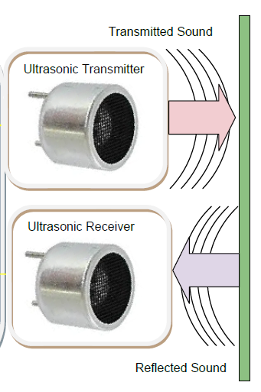
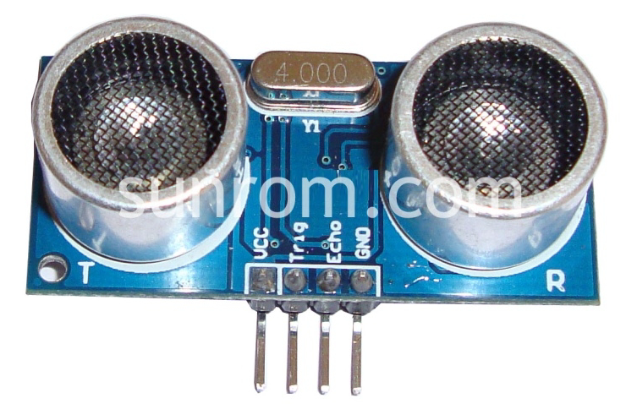
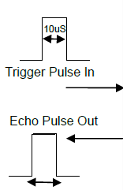
Ultrasonic Sensor

Slide 28
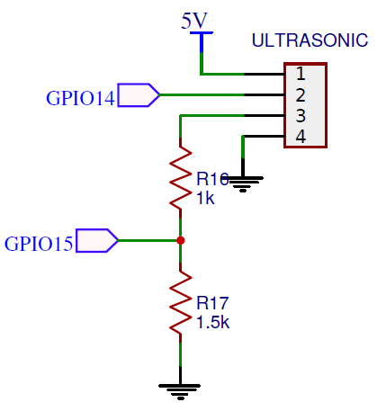
Ultrasonic Connection
TRIG = GPIO14
ECHO = GPIO15

Slide 29
Ultrasonic Sensor
By reading echo pin, we get a duration required
for sound to travel from sensor, collide on a
surface and return back
Speed = distance / time
Distance = speed * time
Here, it’ll be (speed/2) * time
So distance = 34300 /2 = 17150 cm/sec X time

Slide 30
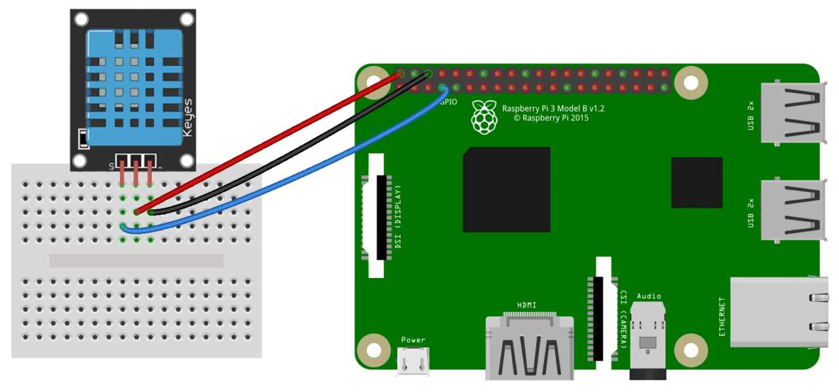
DHT11

Slide 31
DHT11 Dependancies
sudo pip install Adafruit_DHT
sudo apt-get install build-essential python-dev python-openssl
sudo python -m pip install --upgrade pip setuptools wheel
sudo pip3 install Adafruit_DHT

Slide 32
DHT11 Code
import Adafruit_DHT
sensor = Adafruit_DHT.DHT11
pin = 23
humidity, temperature = Adafruit_DHT.read_retry(sensor, pin)
# Note that sometimes you won't get a reading and
# the results will be null (because Linux can't
# guarantee the timing of calls to read the sensor).
# If this happens try again!
if humidity is not None and temperature is not None:
print 'Temp={0}*C Humidity={1}%'.format(temperature, humidity)
else:
print 'Failed to get reading. Try again!'

Slide 33
Internet of Things
Sending data to Internet servers
Receiving data from internet servers
Take Action and perform processing requied

Slide 34
Protocols Used
HTTP Requests
REST
MQTT (Message Queuing Telemetry Transport)
DDS (Data Distribution Service)
AMQP (Advanced message queuing protocol)
JMS (Java Message Service)
CoAP (Constrained Application Protocol)
Many more

Slide 35
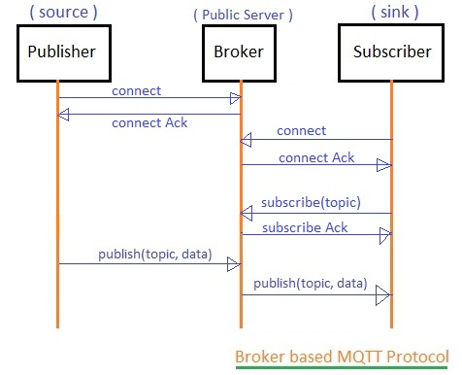
MQTT

Slide 36
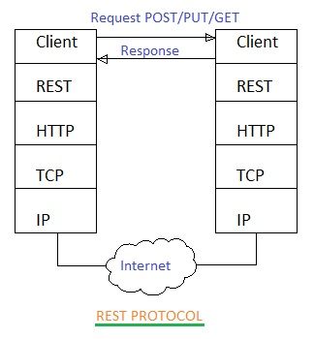
REST

Slide 37
Connecting to Internet
HTTP Requests using urllib2 library
REST API
MQTT API
Ethernet (built-in), plug it in anywhere
Wi-Fi (built_in), configured once per location
3G (dongle), configured once, easy to use

Slide 38
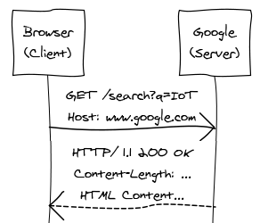
HTTP
HTTP (Hypertext Transfer Protocol) enables the distributed, collaborative system we call the Web
The client sends an HTTP request, the server replies with a response
HTTP Message = Request|Response
Request = (GET|POST|…) Path CRLF *(Header CRLF) CRLF Body
Response = "HTTP/1.1" (200|404|…) CRLF *(Header CRLF) CRLF Body
CRLF = "\r\n"
Note: HTTP is human readable, i.e. it’s easy to debug
Notes:
http://www.websequencediagrams.com/
HTTP
Browser\n(Client)->Google\n(Server): GET /search?q=IoT\nHost: www.google.com
Google\n(Server)-->Browser\n(Client): \nHTTP/ 1.1 200 OK\nContent-Length: ...\nHTML Content...
Google\n(Server)-->Browser\n(Client): \n\n

Slide 39
URLs
The URL (Uniform Resource Locator) is a string of characters used to identify a resource
http://blog.tamberg.org/2011-10-17/side-projects.html
QR codes, NFC tags can contain a machine readable URI
IoT: URLs can refer to things or their physical properties
authority = host [‘:’ port]
path
scheme
Note: good URLs can be hand-written on a napkin and re-typed elsewhere, without any ambiguity
Notes:
(UTF-8!)

Slide 40
Cloud Servers
ThingWorx
Evrythng
SensorCloud
ThingSpeak
Others...
Numerex
Others...
Device Cloud

Slide 41
Cloud Servers
Cayenne
Adafruit
Particle.io
thinger
Others...
Dataplicity
Others...
Xively (pachube)

Slide 42















Microsoft Azure IoT services
Devices | Device Connectivity | Storage | Analytics | Presentation & Action
 | Event Hubs | SQL Database | Machine Learning | App Service
 | Service Bus | Table/Blob Storage | Stream Analytics | Power BI
 | External Data Sources | DocumentDB | HDInsight | Notification Hubs
 |  | External Data Sources | Data Factory | Mobile Services
 |  |  |  | BizTalk Services
{ }

Slide 43
Pattern: Telemetry first
Start with telemetry.
The important data may not be what you expected.
Address privacy, management and security before command & control.
It is very hard to predict in advance what data will be useful.
It is tempting, but likely inefficient to try for business transformation in the first step.
Think about not only device telemetry but also diagnostic telemetry.
Privacy and security implications of telemetry are generally lesser than for command and control.

Slide 44
Microsoft Azure IoT
Use Azure Cloud Shell
Create an IoT hub
Register a device
Send simulated telemetry
Read the telemetry from your hub

